Slide 1
Chapter 7
Democratic Transitions

Slide 2
Waves of Democracy
Huntington defines 3 waves—and 2 reverse waves—of democracy
First wave: 1828-1926
First reverse wave: 1922-1942
Second wave: 1943-1962
Second reverse wave: 1958-1975
Third wave: 1974-?
Maybe we are seeing a third reverse wave? Need the benefit of hindsight.

Slide 3
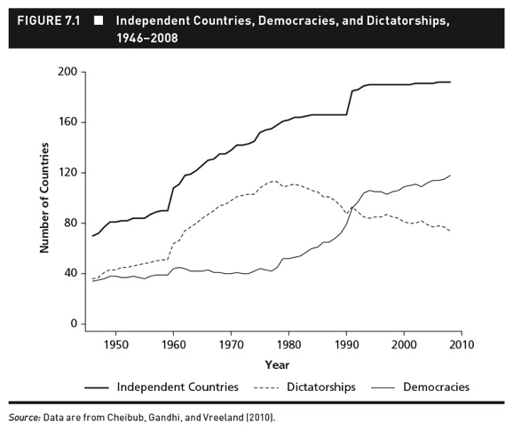
The Rise of Democracy

Slide 4
Two types of transitions
There are two types of democratic transitions
A bottom-up democratic transition is one in which the people rise up to overthrow an authoritarian regime in a popular revolution.
A top-down democratic transition is one in which the dictatorial ruling elite introduces liberalizing reforms that ultimately lead to a democratic transition (though that is never the intention of the liberalizing elite).

Slide 5
Bottom-Up Transition to Democracy
East Germany 1989
The Cold War describes a period of global geopolitical tension in which countries in the Eastern Bloc competed economically, socially, and politically with countries in the Western Bloc.
The symbolic manifestation of the Cold War in Europe was the “Iron Curtain.”
Separated the capitalist West from the communist East

Slide 6
Bottom-Up Transition to Democracy
East Germany 1989
The Cold War lasted for over 40 years.
In 1989, a series of protests and revolutions took place in several East European countries in which the people rose up to demand a transition to democracy.
With the collapse and breakup of the Soviet Union in 1991, the Cold War came to an end.

Slide 7
Bottom-Up Transition to Democracy
East Germany 1989
One of the most dramatic examples of a bottom-up democratic transition occurred in East Germany in November 1989.
Protests on the streets of Leipzig and Berlin forced the Communist East German government to open up the Berlin Wall and allow free multiparty elections.
The end result was the emergence of a democratic East Germany and the eventual reunification of Germany in 1990.

Slide 8
Bottom-Up Transition to Democracy
East Germany 1989
The eventual collapse of communism in East Germany had much to do with the election of Mikhail Gorbachev.
Gorbachev inherited a Soviet Union in crisis.
Gorbachev responded to these crises with two reform policies intended to save the Soviet Union:
Perestroika “restructuring”
Glasnost “openness”

Slide 9

Klaus Meine of the Scorpions wrote Wind of Change partly as a response to the changes he saw in Moscow during the glastnost period.

Slide 10
Bottom-Up Transition to Democracy
East Germany 1989
The liberalizing reform policies introduced by Gorbachev in the Soviet Union encouraged reformists and opposition groups in other countries in Eastern Europe.
People at the time didn’t see them as signs of the imminent collapse of Communist control.
Nobody predicted the fall of the Berlin Wall, much less the entire Soviet system.

Slide 11
Bottom-Up Transition to Democracy
East Germany 1989
The situation began to change when Hungary decided to open its border with Austria in August 1989, breaching the Iron Curtain.
Thousands of East Germans had left their possessions and relatives for freedom.
The willingness of East Germans to leave so much behind is further evidence that few at the time foresaw the imminent collapse of the Communist system in East Germany.

Slide 12
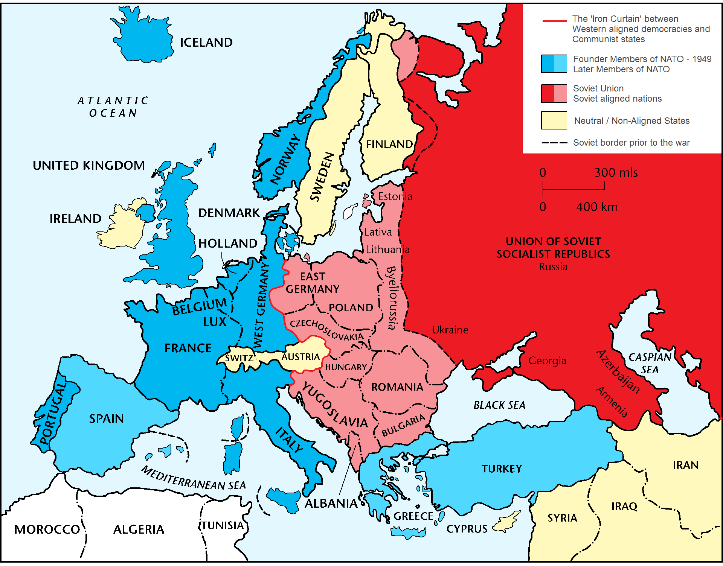

Slide 13
Bottom-Up Transition to Democracy
East Germany 1989
Although tens of thousands of East Germans fled the country
the mass protests continued and were emboldened when Gorbachev announced that the Soviets would no longer intervene militarily in Eastern Europe to prop up Communist governments
Reunification finally took place on October 3, 1990, when the areas of the former German Democratic Republic were incorporated into the Federal Republic of Germany.

Slide 14
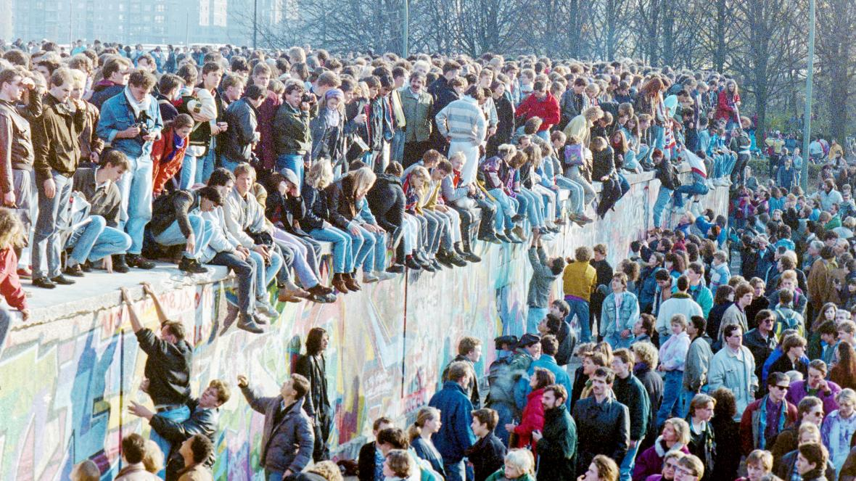

Slide 15
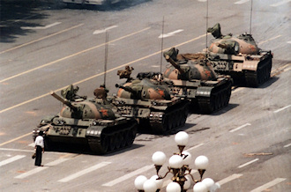
Tank Man: not all revolutions are successful

Slide 16
Bottom-Up Transition to Democracy
Collective Action Theory
Collective action theory focuses on forms of mass action, or “collective action,” such as the protests in East Germany in 1989.
Examples: revolutions, interest group activities, strikes, elections, and so on.
Collective action concerns the pursuit of public goods by groups of individuals.

Slide 17
Bottom-Up Transition to Democracy
Collective Action involves the pursuit of public goods by a group of individuals.
A public good has two characteristics:
Nonexcludability
A good is nonexcludable if you can’t prevent those in the group who didn’t contribute to its supply from consuming it.
Nonrivalry
A good is nonrivalrous if its consumption by one individual doesn’t reduce the amount available for consumption by other individuals in the group.
Notes:
What are some examples of public goods? Clean air, lighthouses, etc.

Slide 18
Bottom-Up Transition to Democracy
Collective Action Theory
The nature of public goods makes them quite desirable.
You might expect that groups of individuals with common interests would act collectively to achieve those interests.
Because non-excludability creates a free-rider problem, this is not always the case.

Slide 19
Bottom-Up Transition to Democracy
Collective Action Theory
Free rider problem
Refers to the fact that individual members of a group—because of the non-excludable nature of public goods—often have little incentive to contribute to the provision of a public good that will benefit all members of the group.
Whether or not they contribute, does not affect the whether the good is provided or not, so why bother to pay the cost?

Slide 20
Bottom-Up Transition to Democracy
Collective Action Theory
Imagine a group of N=100 individuals
If K=50 people contribute or participate, then the public good is provided.
If the public good is provided, all 100 group members get a benefit.
If a group member contributes or participates, then he or she pays a cost.
Let’s assume that the value of the benefit of the good to every individual outweighs the cost of contributing.
Would you contribute to the public good?

Slide 21
Bottom-Up Transition to Democracy
Collective Action Theory
Scenario 1: It makes no sense for you to participate in if you expect that fewer than 49 others will participate – no public good no matter what you do!
Scenario 2: It also makes no sense for you to participate if you conjecture that at least 50 others will participate– public good no matter what you do!
Scenario 3: It only makes sense for you to participate if you expect that exactly 50-1 others will participate.
Public good only if you participate!

Slide 22
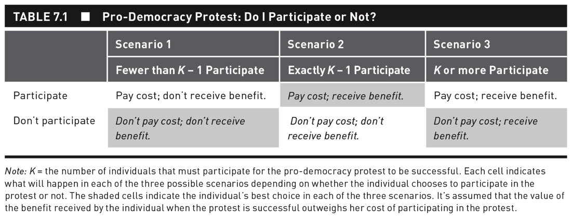

Slide 23
Bottom-Up Transition to Democracy
Collective Action Theory
Two factors are crucial for determining the success of collective action:
The difference between K and N
The size of N

Slide 24
Bottom-Up Transition to Democracy
Collective Action Theory
Collective action is less likely to be successful when the number of group members required for success, K, is significantly smaller than the number of people who will benefit from the success, N.
Also when N is larger, not matter the size of K, it is more difficult to monitor and punish free-riders
Paradoxically, larger groups are less likely to successfully overcome the collective action problem.
Notes:
Think about what this means for the East German example. Help explain it.

Slide 25
Bottom-Up Transition to Democracy
Collective Action Theory
The relationship between group size and successful collective action has some important and counterintuitive implications.
The free-rider problem is likely to damage the ability of large groups to conduct forms of collective action much more than that of small groups.

Slide 26
Bottom-Up Transition to Democracy
Tipping Models
One explanation for the mass protests that occurred in East Germany can be found in what political scientists call “tipping,” or “threshold,” models.
Individuals have a private preference (what they really think) and a public preference (that they reveal to the world).
When the public preference doesn’t match the private one, then an individual is engaging in preference falsification.

Slide 27
Bottom-Up Transition to Democracy
Tipping Models
The protest size at which an individual is willing to participate as her revolutionary threshold.
A revolutionary threshold is the size of protest at which an individual is willing to participate.
Individuals have different revolutionary thresholds.
People’s thresholds are likely to depend on many different factors.

Slide 28
Revolutionary Cascades
Imagine a 10-person society (A) with the following threshold sequence:
A = {0, 2, 2, 3, 4, 5, 6, 7, 8, 10}.
T₁ = 0: always supports the opposition.
T₅ = 4: supports government if 0 < S < 4 but joins the opposition if 4 < S < 10.
T₁₀= 10: always supports government.

Slide 29
An Example—Society A
A = {0, 2, 2, 3, 4, 5, 6, 7, 8, 10}.
Person 1 will publicly oppose the government, but no others will join him.
Persons 2 and 3 would join if two people revolted, but only one has. Thus, they do not revolt.

Slide 30
Another Example—Society A′
Suppose Person 2 becomes more alienated from the government and her threshold drops to 1.
A’ = {0, 1, 2, 3, 4, 5, 6, 7, 8, 10}.
What happens now?

Slide 31
A New Example—A′
Suppose Person 2 becomes more alienated from the government and her threshold drops to
A’ = {0, 1, 2, 3, 4, 5, 6, 7, 8, 10}
Nine-person revolt.
Person 1 revolts, which causes person 2 to revolt, which causes person 3 to revolt, and so on.
Only Person 10 does not join in.
A slight shift in one person’s threshold generates a REVOLUTIONARY CASCADE.

Slide 32
Two New Examples—B and B′
Compare the original society A with a new one B, where Person 3 has a higher threshold of 3 instead of 2.
B = {0, 2, 3, 3, 4, 5, 6, 7, 8, 10}.
Result: One-person revolt.
Person 2’s threshold now drops to 1.
B′ = {0, 1, 3, 3, 4, 5, 6, 7, 8, 10}.
Result: Two-person revolt. No revolutionary cascade.

Slide 33
Bottom-Up Transition to Democracy
Tipping Models
The distribution of revolutionary thresholds in a society is crucial for determining whether a revolution occurs,
The slight shift in a revolutionary threshold of one individual has causes revolutionary cascades.
When one person’s participation triggers the participation of another, which triggers the participation of another.

Slide 34
Bottom-Up Transition to Democracy
Tipping Models
Each individual knows her own revolutionary threshold, but not that of anyone else.
This means that a society can come to the brink of revolution without anyone’s ever knowing it.
People may be ready to participate in a full-scale revolt as long as one more person goes out to protest.

Slide 35
Bottom-Up Transition to Democracy
Tipping Models
Our inability to observe both private preferences and thresholds conceals potential revolutionary cascades and makes it impossible to predict when a revolution will occur.
Revolutions will always come as a surprise!

Slide 36
Top-Down Transitions
Top-down transitions result primarily from a policy of liberalization on the part of authoritarian elites themselves.
Policy of liberalization: a controlled opening of the political space and might include the formation of political parties, holding elections, writing a constitution, judicial and legislative reforms, etc.

Slide 37
Top-Down Transitions
The policy of liberalization is designed to stabilize a dictatorship, but sometimes leads to democracy.
Periods of liberalization have preceded many transitions to democracy throughout history.
Brazil 1982-85
Uruguay 1983-84
Poland 1980s

Slide 38
Top-Down Transitions to Democracy
A Strategic Theory to Top-Down Democratic Transitions
Top-down democratic transitions result from a split between soft-liners and hard-liners in an authoritarian regime.
The hard-liners are usually satisfied with the political status quo.
Soft-liners are concerned may prefer to liberalize and broaden the social base of the dictatorship in an attempt to gain allies, strengthen their position in relation to the hard-liners, and manage (e.g. divide and conquer) opposition groups.

Slide 39
Top-Down Transitions to Democracy
A Strategic Theory to Top-Down Democratic Transitions
Policies of liberalization
Entails a controlled opening of the political space and might include the formation of political parties, holding elections, writing a constitution, and so on.
The intended goal is not a democracy, but what we might call a broadened dictatorship.
They are common in the world today.

Slide 40
Top-Down Transitions to Democracy
A Strategic Theory to Top-Down Democratic Transitions
You might wonder why authoritarian elites don’t always liberalize.
The problem is that the soft-liners can’t guarantee that liberalization will successfully produce a broadened dictatorship.
Because of preference falsification, it is difficult for soft-liners to gauge true support for opposition
So, the liberalization process is inherently unstable.

Slide 41
Top-Down Transitions
A Strategic Theory to Top-Down Democratic Transitions
If the soft-liners do liberalize, then the democratic opposition has two options:
It can accept the concessions offered by the authoritarian elites and enter the institutions of a broadened dictatorship.
This is more likely if opposition knows it is not strong enough to fight for more reforms
The democratic opposition can take advantage of its new freedoms to further organize and mobilize against the dictatorship.
More likely when opposition is strong

Slide 42
Top-Down Transitions to Democracy
A Strategic Theory to Top-Down Democratic Transitions
If the democratic opposition does choose to continue, then this is evidence that the controlled opening initiated by the soft-liners has failed
Two choices are available to the authoritarian elites:
Use force in an attempt to repress popular mobilization and restore order
Accept its demands and allow the emergence of truly democratic institutions
Notes:
The choice by the authoritarian elite to stick with the political status quo or liberalize depends on how it thinks the democratic opposition will respond to liberalization

Slide 43
Top-Down Transitions
Applying our Theory to the Prague Spring
In 1968 soft-liner Alexander Dubcek replaced a hard-liner as leader, and increased freedom of speech and the press and encourage more political participation
This encouraged the opposition; the people demanded more reforms; Social Democrats formed their own party.
When Dubcek refused to reverse the reforms, the Soviets invaded and replaced Dubcek with hard linver Gustav Husak, who reversed the reforms and violently repressed the opposition.
Result: Hard-line dictatorship.

Slide 44
Top-Down Transitions
Applying our Theory to Poland
Initial reform attempts backfired and led to greater repression (1981)…but led to rise of Solidarity
Second reform undertaken by regime with inflated beliefs about its own strength, and mistaken beliefs about the strength of the opposition Solidarity
Regime agreed to have legislative elections, but reserved 65% of lower house seats for the Communists and other regime backed parties
Solidarity won all but one of competitive elections, and joined with a regime backed party to gain a majority and install a non-Communist Prime Minister.
Liberalization gave way not to a broadened dictatorship, but regime change!

Slide 45


Marek Kaminski

